Slide 1
Feedme

Slide 2




Slide 8


Slide 9

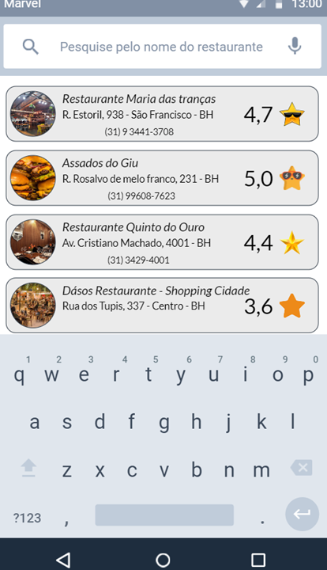

Slide 12

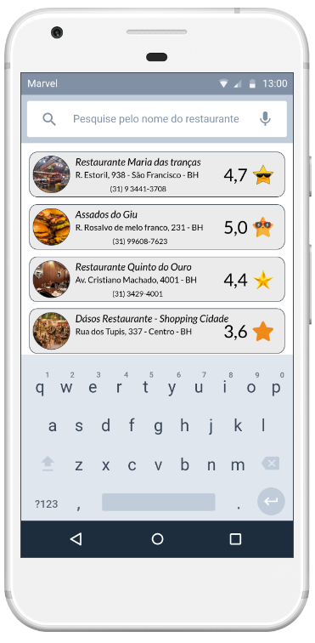

Slide 14


